Slide 1
DIGITAL PORTFOLIO
STUDENT NAME: KARTHIK K
REGISTER NO AND NMID: 32324u09031 &
aastvu32332324u09031
DEPARTMENT: BCA
COLLEGE: Voorhees College/Thiruvalluvar University

Slide 2
Presentation title
2
Project Title Digital portfolio
Student digital portfolio
Using html,css and javascript…

Slide 3
Presentation title
3
AGENDA:
Problem Statement
Project Overview
End Users
Tools and Technologies
Portfolio design and Layout6
Features and Functionality
Results and Screenshots
Conclusion
Github Link

Slide 4
Presentation title
4
PROBLEM STATEMENT
Many students and beginners in web development struggle to showcase their skills effectively. A personal portfolio website provides a professional way to display projects, share contact details, and demonstrate technical abilities.

Slide 5
Presentation title
5
PROJECT OVERVIEW
This project is a responsive personal portfolio website built with HTML, CSS, and JavaScript. It includes sections such as Home, About, Projects, and Contact. The website is mobile-friendly and highlights both design and functionality.

Slide 6
Presentation title
6
End Users
Students who want to showcase academic or personal
projects
Recruiters and employers reviewing candidate skills Anyone interested in the student’s journey and projects

Slide 7
Presentation title
7
Tools and Technologies
HTML5 – for structuring content
CSS3 – for styling and responsive layout
JavaScript (ES6) – for interactivity (menu toggle, smooth scrolling)
GitHub – for version control and hosting

Slide 8
PORTFOLIO DESIGN AND LAYOUT
Presentation title
8
Header & Navbar: Sticky navigation with toggle menu for mobile
Hero Section: Introduction with name and tagline
About Section: Profile image and student background
Projects Section: Grid of project cards
Contact Section: Email and phone details

Slide 9
FEATURES AND FUNCTIONALITY
Presentation title
9
Responsive design (desktop & mobile) Interactive navigation menu
Project showcase with hover effects
Contact section with clickable email/phone links

Slide 10
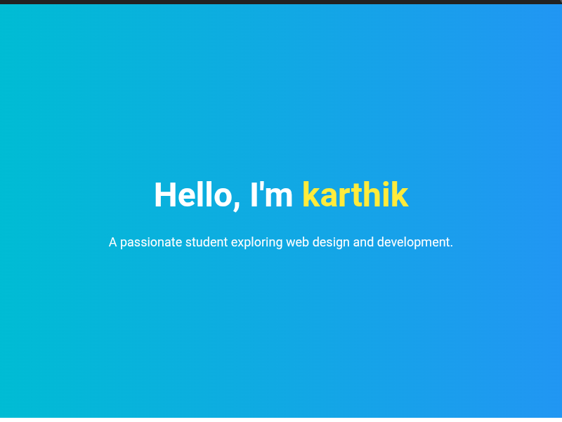
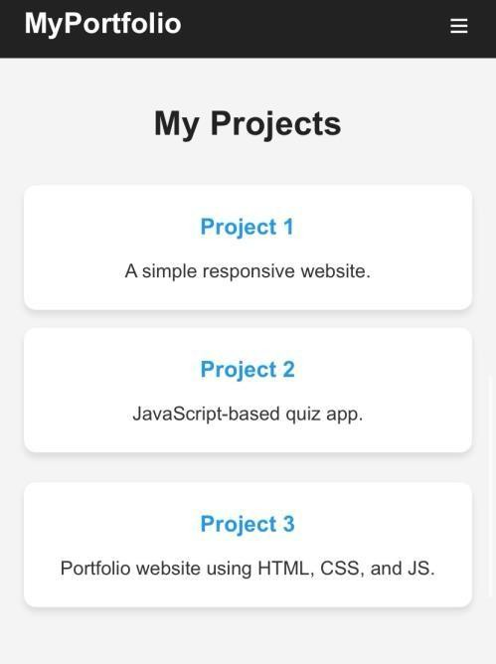
Results and Screenshots
10

Slide 11
CONCLUSION
The portfolio website provides a professional platform to highlight skills and projects. It demonstrates the use of fundamental web technologies and serves as a foundation for more advanced web development.

